Slide 1
3x3 Middle Layer Edges and First Two Layers
COLL 134
Week 4

Slide 2
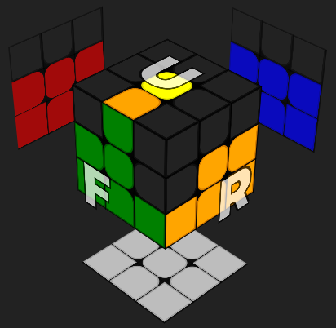
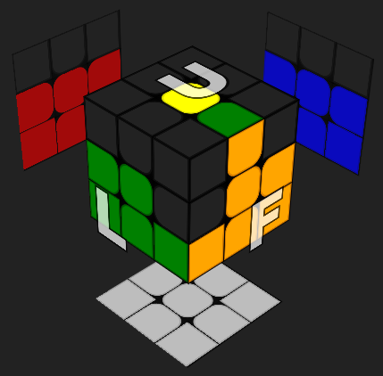
Middle Layer Edges
Only 4 pieces to solve
Middle layer edges will never contain the last layer color
First step: align side-facing color of edge with corresponding center
Insert to the RIGHT
Insert to the LEFT
Algorithm: U R U’ R’ U’ F’ U F
Algorithm: U’ L’ U L U F U’ F’

Slide 3
Algorithm Mechanics
Insert RIGHT: U R U’ R’ U’ F’ U F
Insert LEFT: U’ L’ U L U F U’ F’
1. 2. 3.
Reposition edge
Pair edge with corner
Insert edge-corner pair
*These algorithms are mirrors of each other

Slide 4
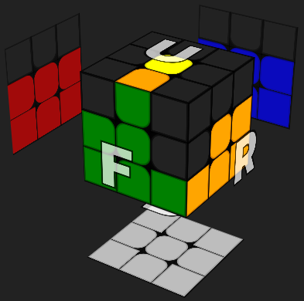
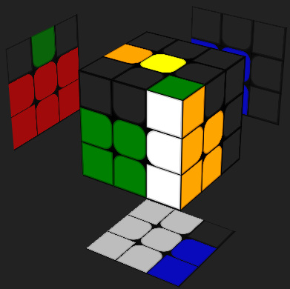
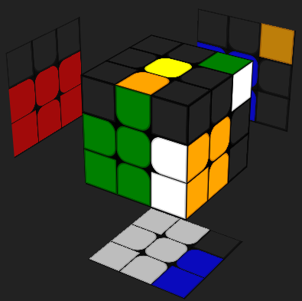
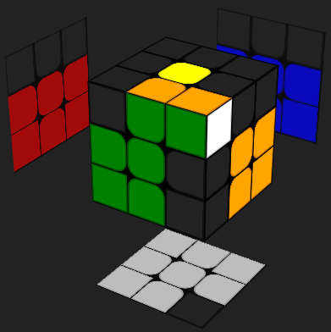
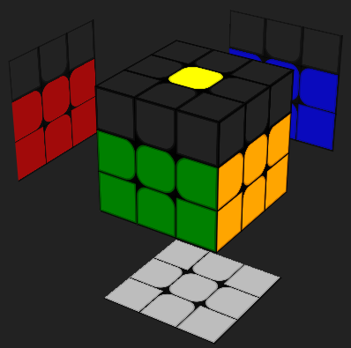
U R
U’
Inserting Right
1st vector pairs corner with edge
2nd vector restores white cross
Vectors become “aligned” in the same direction
R’
U' F' U F
Insert corner-edge pair as normal
Notes:
Insert right demo: https://www.cubedb.net/?puzzle=3&scramble=z2_F-_U_F_U_R_U-_R-_U-&alg=U_R_U-_R-_U-_F-_U_F&stage=f2l&crosscolor=white

Slide 5
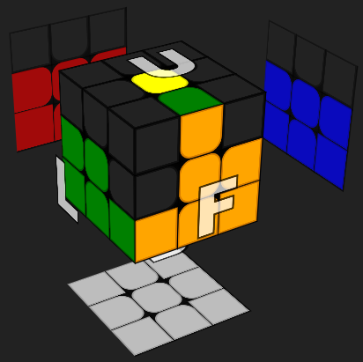
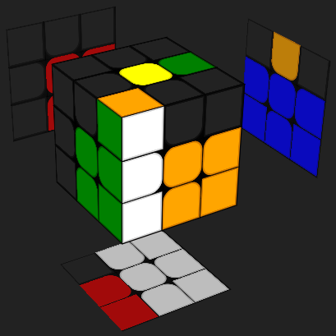
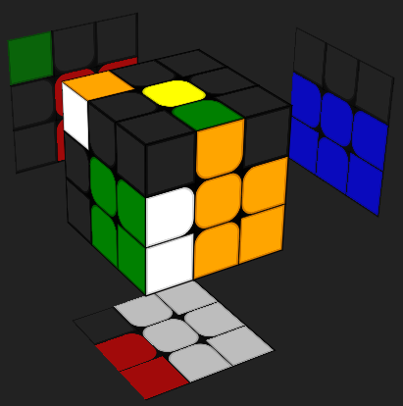
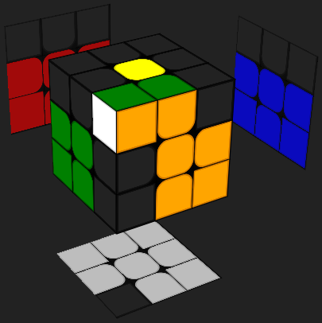
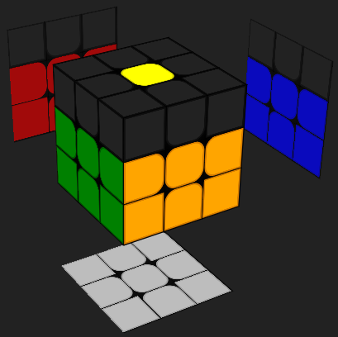
U’ L’
U
Inserting Left
1st vector pairs corner with edge
2nd vector restores white cross
Vectors become “aligned” in the same direction
L
U F U’ F’
Insert corner-edge pair as normal
Notes:
Insert left demo: https://www.cubedb.net/?puzzle=3&scramble=z2_R_U-_R-_U-_F-_U_F_U_y&alg=U-_L-_U_L_U_F_U-_F-&stage=f2l&crosscolor=white

Slide 6
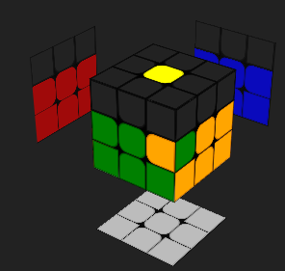
Middle Layer Scenario
What if a middle layer edge looks like this?

Slide 7
First Two Layers (F2L)
Beginner middle layer is extremely inefficient
8 moves to solve 1 edge, 16 moves if edge is flipped
Solution: combine first layer corners with middle layer edges
For each F2L “slot,” solve its corner and edge together

Slide 8
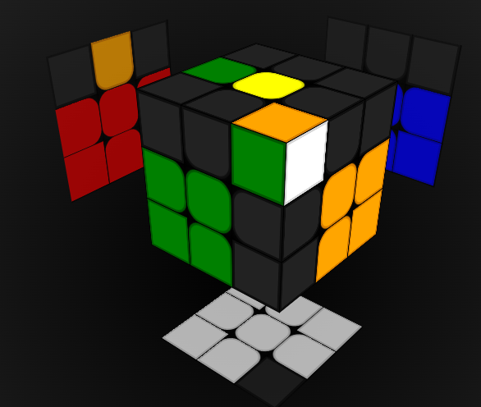
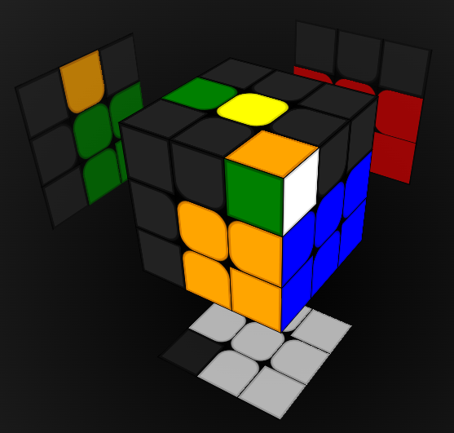
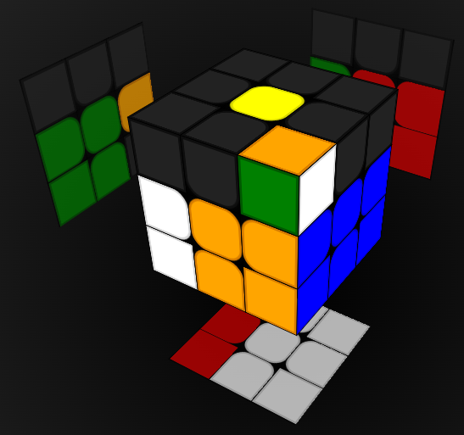
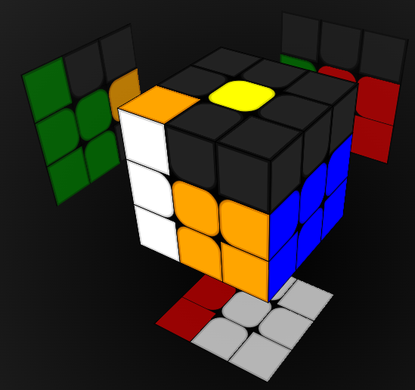
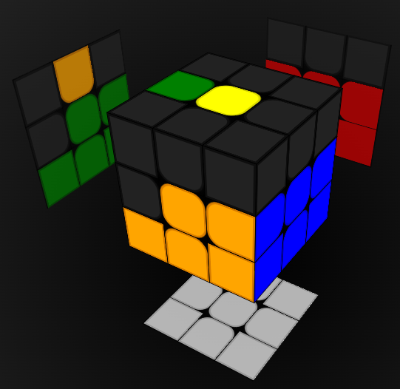
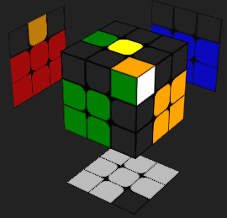
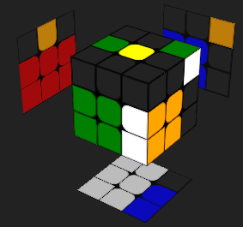
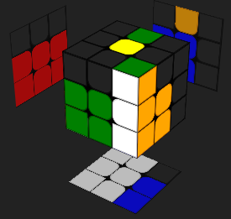
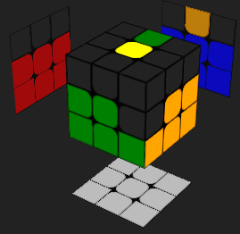
F2L Fundamentals
Exploit corner insertion mechanics for simultaneous edge insertion
Method 1
Method 2

Slide 9
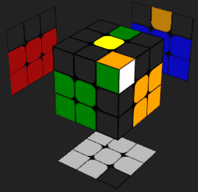
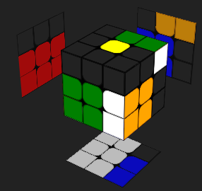
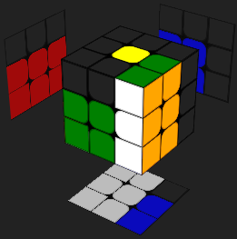
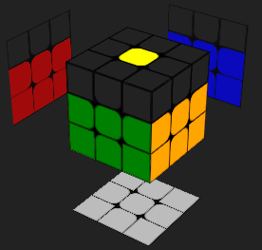
F2L Fundamentals
Insertion Method 2
??

Slide 10
F2L Example Cases
41 total cases, all listed in Ruwix reading with algorithms
Intuition > Algorithms
Scramble 1: z2 B D F D2 L U' B L2 F D' B2 D L2 F2 D2 R2 U' B2 D B2 L2
Example cross: F U' F R' B' D2 R’ or z2 F D' F L' B' U2 L'
Scramble 2: z2 L2 U2 R2 B' L2 B' L2 B' D2 F D2 L' R' U F U R' D2 F
Example cross: F R2 B' L’ D2 or z2 F L2 B' R' U2

